Slide 1
Say Hello to HS Dashboard
Data Source: Brazil Ecommerce Data
Group 10

Slide 2
01
Who We Are?

Slide 3
Welcome to Higher Score (HS)
Online Shopping Platform
Higher score
- Higher Score as a start-up online shopping platform is in its growing stage.
- We help sellers and buyers connect to each other in the easiest way, supported by our powerful digital analysis center.
Customized
suggestion
Personalized
recommendation
Seller
Buyer
Slogan
“Get everything you want with one single click!”

Slide 4
02
Our Project

Slide 5

Higher Score Dashboard
“Higher Score Dashboard – Identify Problem!”
Slogan
Our Goal
- Earning profit by providing dashboard service to sellers
- Attracting more users to our platform by helping sellers provide better online shopping experience to their customer
Target User
- Individual sellers
- Brand managers
- Industry researchers
- Others who want to know about online business

Slide 6
Acquisition
Sales
Metrics System
Review
Repurchase
- Acquisition Volume & Monthly Growth
- GMV Volume & Monthly Growth
- Acquisition Trend By Different Origins
- Product Category GMV Change
- Average Review Score
- RFM Scores
- Review Keywords
- Eight Customer
Groups

Slide 7
Let’s look at Our Visualization!

Slide 8
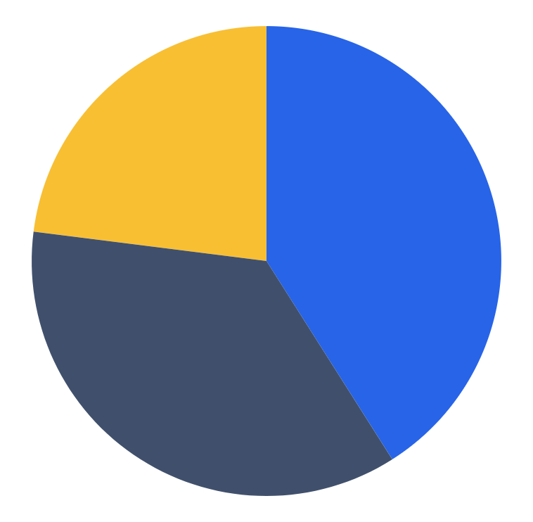
Repurchase: RFM Model
Total transaction value by each customer
Recency
Monetary
Time since last order made on product
The number of orders made by each customer
Frequency

Slide 9
Our Eight Segmented Groups
Group Recency Frequency Monetary
Important Valuable Customer
High
High
High
Important Developing Customer
High
Low
High
Important Maintaining Customer
Low
High
High
Important Retaining Customer
Low
Low
High
Normal Valuable Customer
High
High
Low
Normal Developing Customer
High
Low
Low
Normal Maintaining Customer
Low
High
Low
Normal Retaining Customer
Low
Low
Low

Slide 10
03
Risk & Future Plan

Slide 11
Risk and Solution
Data and IT Risk
Organizational Alignment Risk
Data Breach
- Hacker attack
- Risk assessment
Data Breach
- Collection and retention of data
- Follow the related privacy regulation
Data Fraud
- Fraud sales data
- outlier detection
Data Inaccuracy
- Identity overlapping
- Identity stripping

Slide 12
Timeline
Through A/B testing verify the effect of the HS dashboard
Promoting the HS dashboard to all the sellers of the platform
Provide premium data analysis service to sellers and other third-parties
Metrics of Success
✔️ Number of users of HS dashboard
✔️ Number of users registering for our premium service

Slide 13
Thank you!
Any questions?

